Slide 1
Probability and Information Theory
Dr. Sifat Momen

Slide 2
Probability Theory
Mathematical framework for representing uncertain statements.
Provides a means of quantifying uncertainty as well as axioms for deriving new uncertain statements.
Axiom = statement/proposition which is regarded as being established, accepted or self-evidently true.

Slide 3
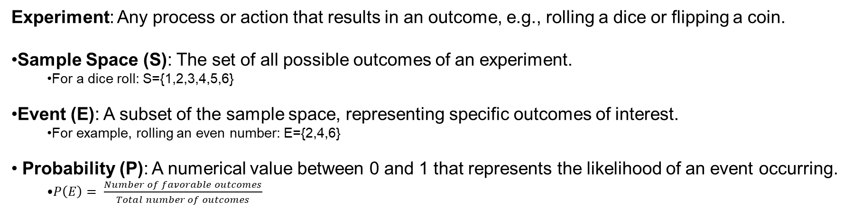
Key concepts in Probability Theory
Experiment: Any process or action that results in an outcome, e.g., rolling a dice or flipping a coin.
Sample Space (S): The set of all possible outcomes of an experiment.
For a dice roll: S={1,2,3,4,5,6}
Event (E): A subset of the sample space, representing specific outcomes of interest.
For example, rolling an even number: E={2,4,6}
Probability (P): A numerical value between 0 and 1 that represents the likelihood of an event occurring.
$P\left(E\right)= \frac{Number of favorable outcomes}{Total number of outcomes}$

Slide 4
Interpretation of Probability
Frequentist Probability
Probability is defined as the long-run relative frequency of an event occurring in repeated, identical trials.
Example: If you flip a fair coin many times, the probability of getting heads is the proportion of heads in the long run (e.g., 50%).
https://www.statcrunch.com/applets/type3&coins
Bayesian Probability
Probability is a measure of belief or certainty about an event, based on prior knowledge or evidence.
Example: Probability that a patient has a flu is 40%

Slide 5
Example Comparison
Scenario: Tossing a coin 10 times, you observe 7 heads and 3 tails.
Frequentist Approach:
Calculate the probability of heads assuming repeated flips.
No prior assumptions are made about the coin's bias; the coin's fairness is evaluated solely based on observed data.
Bayesian Approach:
Start with a prior belief about the coin's bias (e.g., 50% heads).
Update the belief using Bayes' theorem based on observed data (7 heads, 3 tails). The result is a posterior distribution reflecting the updated belief.

Slide 6
Random Variable
A random variable is a variable that takes on values determined by the outcome of a random phenomenon or experiment.
Types:
Discrete Random Variable: Takes on a finite set of distinct values (e.g., integers).
Example: The number of heads in 3 coin flips (X∈{0,1,2,3}). Continuous Random Variable: Takes on an uncountably infinite set of values, often over an interval. Example: The exact time (in seconds) a train arrives at a station.

Slide 7
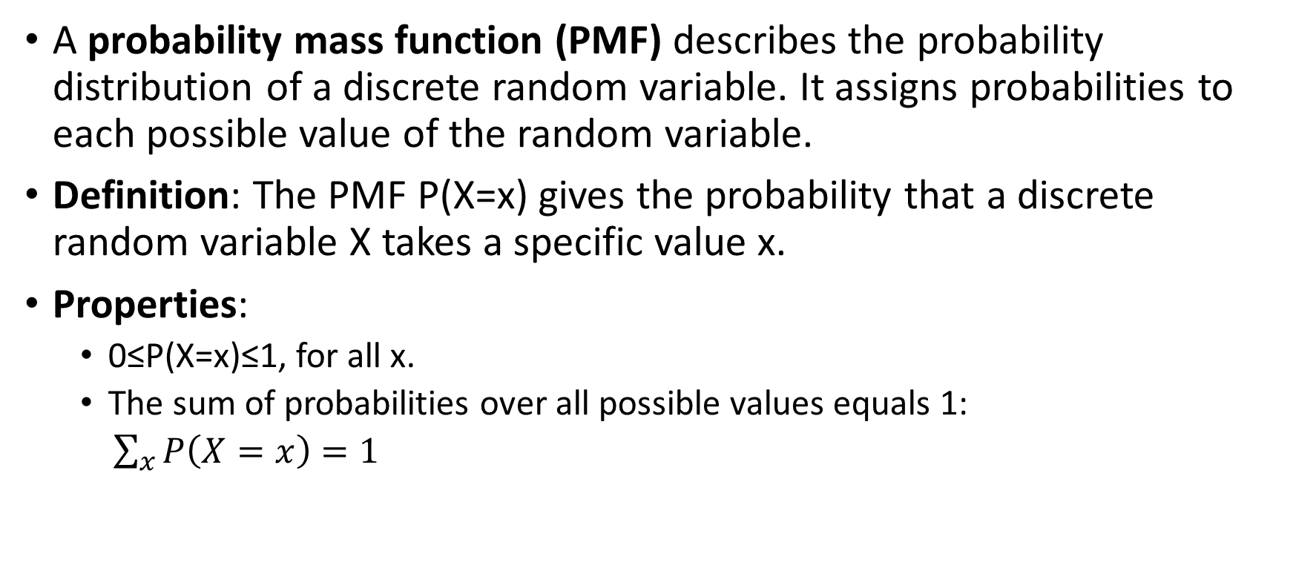
Probability Mass Function (PMF)
A probability mass function (PMF) describes the probability distribution of a discrete random variable. It assigns probabilities to each possible value of the random variable.
Definition: The PMF P(X=x) gives the probability that a discrete random variable X takes a specific value x.
Properties:
0≤P(X=x)≤1, for all x.
The sum of probabilities over all possible values equals 1:
$\sum_{x}{P\left(X=x\right)=1}$

Slide 8

Uniform Distribution
$P\left(X= x_{i}\right)= \frac{1}{k}$
$\sum_{i}{P\left(X= x_{i}\right)= \sum_{i}{\frac{1}{k}=1}}$

Slide 9
Example – 1

Slide 10
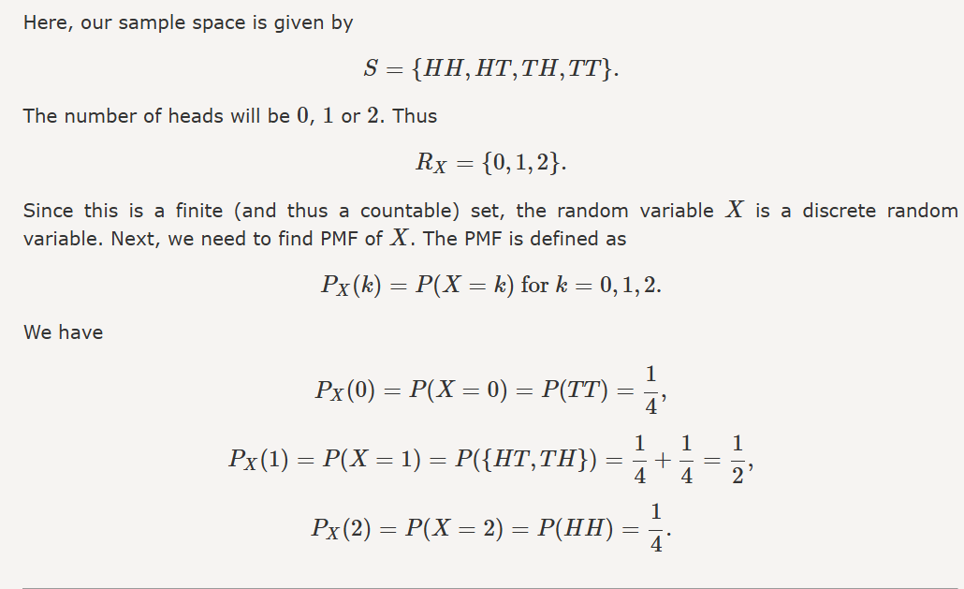
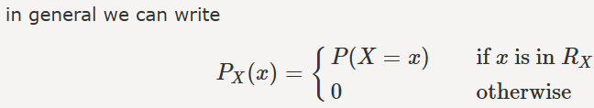
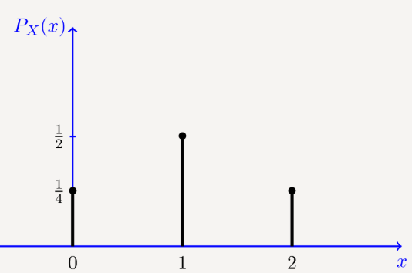
Example – 1 Solution

Slide 11
Example – 2

Slide 12
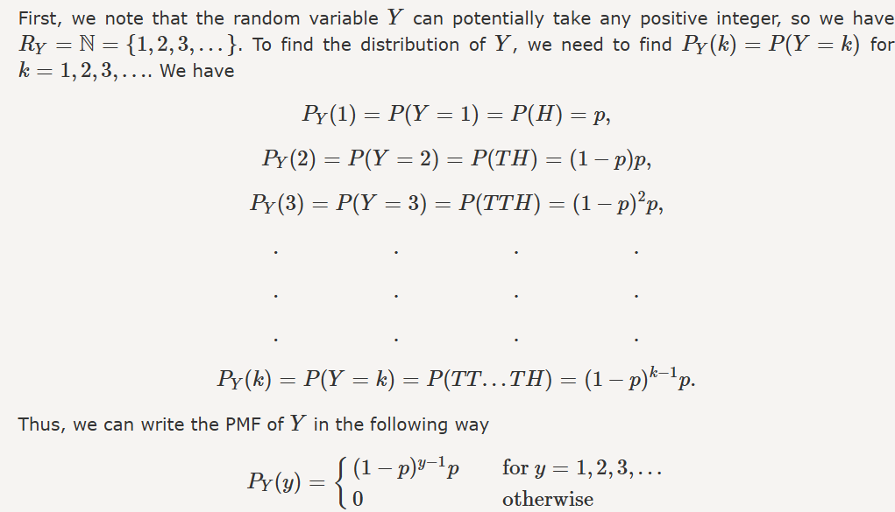
Example – 2 Solution

Slide 13
Continuous Variable
A continuous variable is a type of random variable that can take on an infinite number of possible values within a given range. These values are uncountable and are often measurements.
Examples:
Height of a person (e.g., 5.7 feet, 5.71 feet, 5.713 feet, etc.).
Temperature in a city (e.g., 25.3°C, 25.31°C, etc.).
Time taken to finish a task (e.g., 12.5 seconds, 12.51 seconds, etc.).

Slide 14
Probability Density Function
A probability density function (PDF) describes the probability distribution of a continuous random variable. Unlike the PMF for discrete variables, the PDF does not give the probability of the random variable taking a specific value (since the probability at a single point is zero). Instead, it defines the likelihood of the variable falling within a particular range.

Slide 15
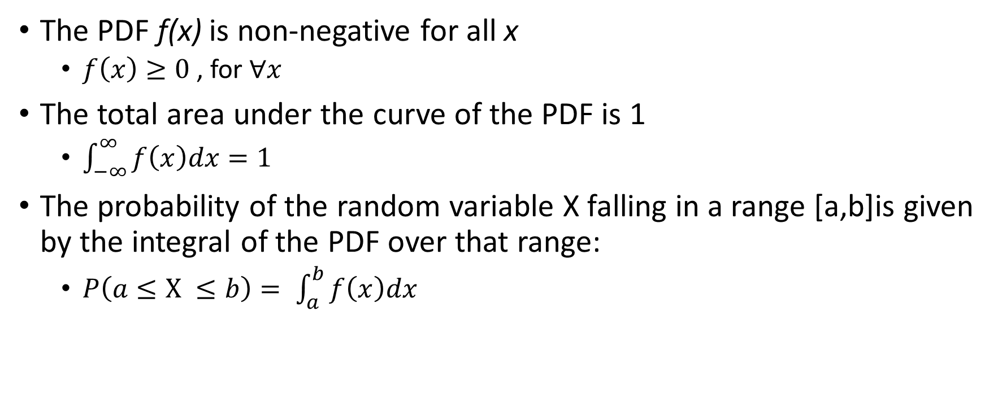
PDF – Key Properties
The PDF f(x) is non-negative for all x
$f\left(x\right)≥0$, for $∀x$
The total area under the curve of the PDF is 1
$\int_{−∞}^{∞}{f\left(x\right)dx=1}$
The probability of the random variable X falling in a range [a,b]is given by the integral of the PDF over that range:
$P\left(a≤X ≤b\right)= \int_{a}^{b}{f\left(x\right)dx}$

Slide 16
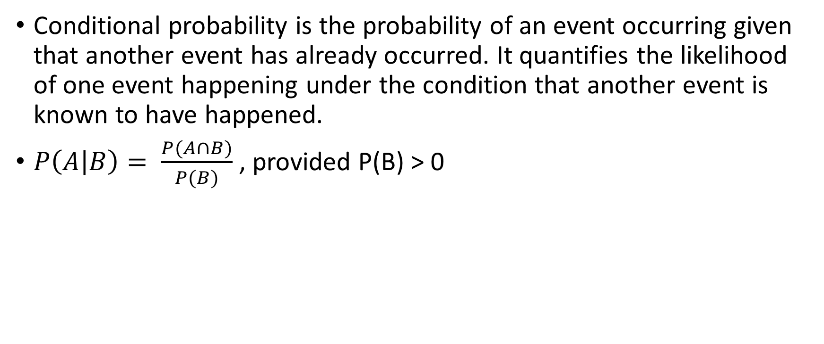
Conditional Probability
Conditional probability is the probability of an event occurring given that another event has already occurred. It quantifies the likelihood of one event happening under the condition that another event is known to have happened.
$P\left(A | B\right)= \frac{P(A∩B)}{P(B)}$ , provided P(B) > 0

Slide 17
Chain Rule of Conditional Probabilities
The chain rule is a fundamental principle in probability theory that expresses the joint probability of multiple events in terms of conditional probabilities. It provides a way to break down the joint probability of several events into a product of sequential probabilities.
Joint probability is the probability of two or more events occurring simultaneously. It describes the likelihood of multiple events happening together and is a key concept in probability theory.

Slide 18
Chain Rule of Conditional Probabilities

Slide 19
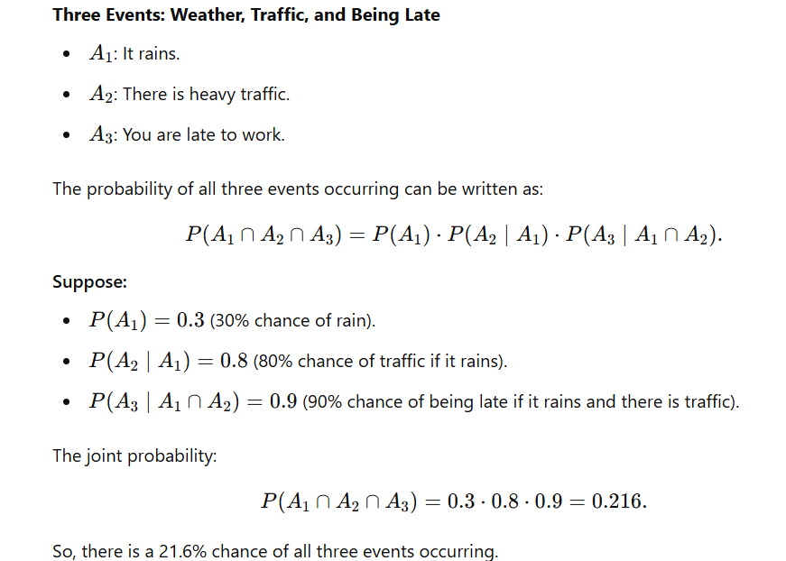

Slide 20
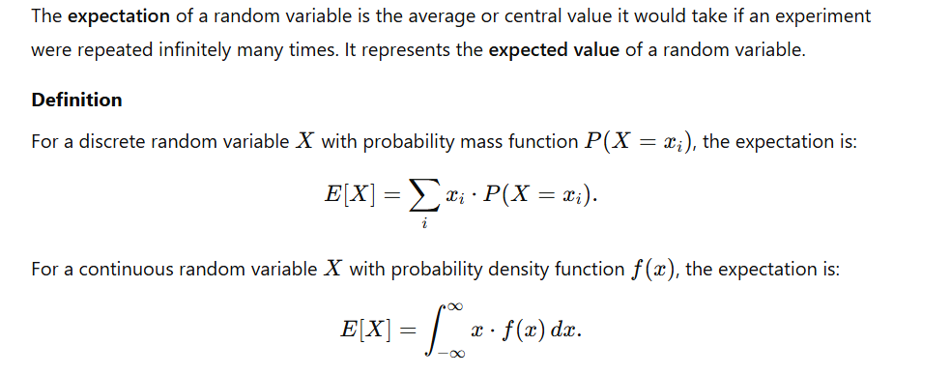
Expectation

Slide 21
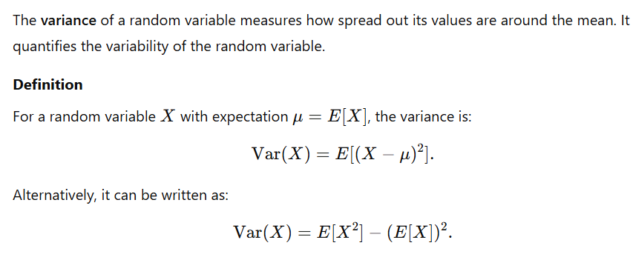
Variance

Slide 22
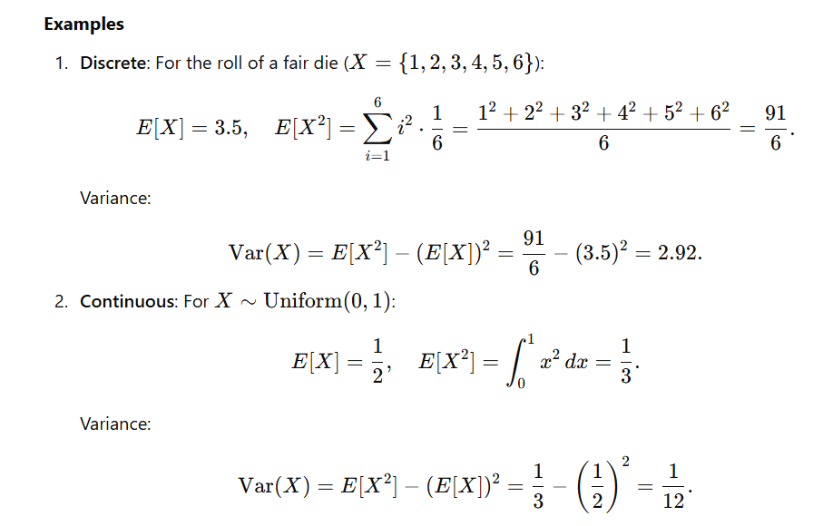

Slide 23
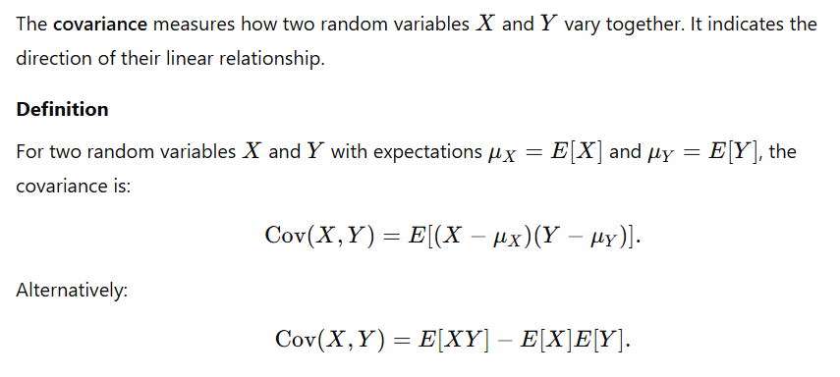
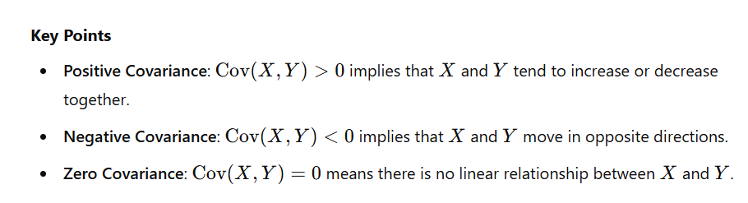
Covariance

Slide 24
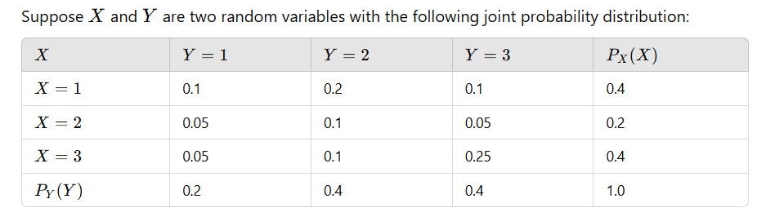
Determine the covariance of X and Y

Slide 25
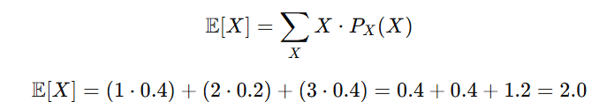
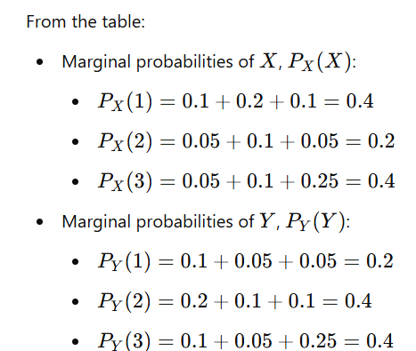
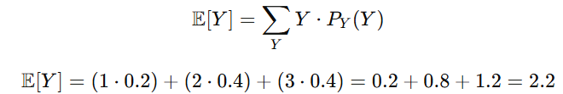
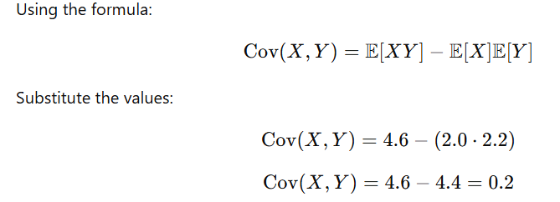
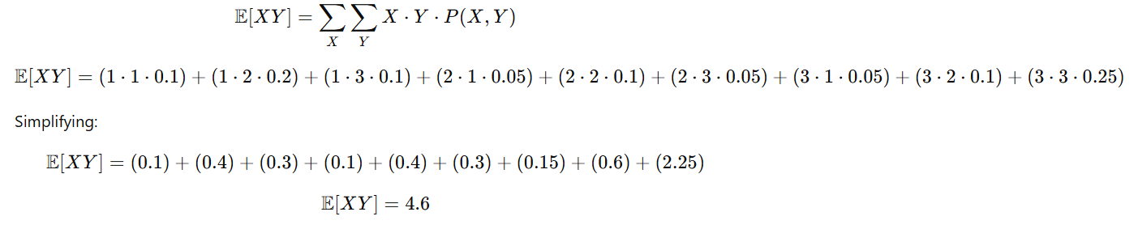
Solution

Slide 26
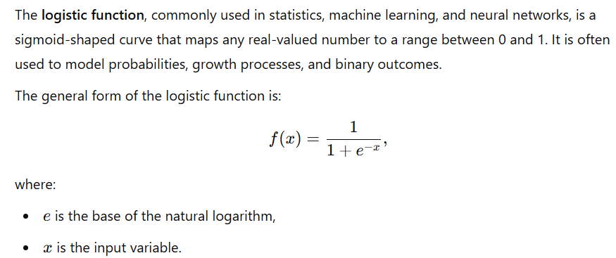
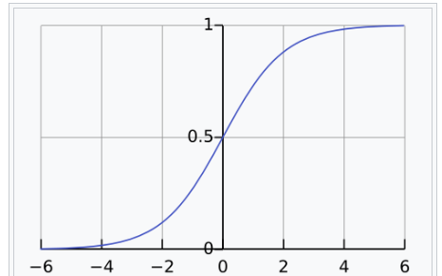
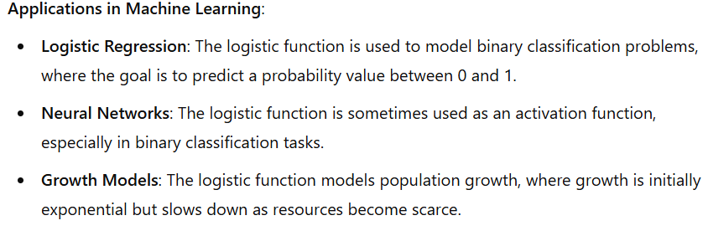
Useful Properties of Common Functions
Logistic Function

Slide 27
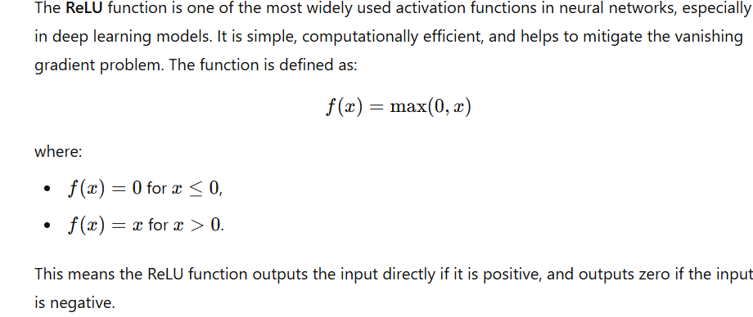
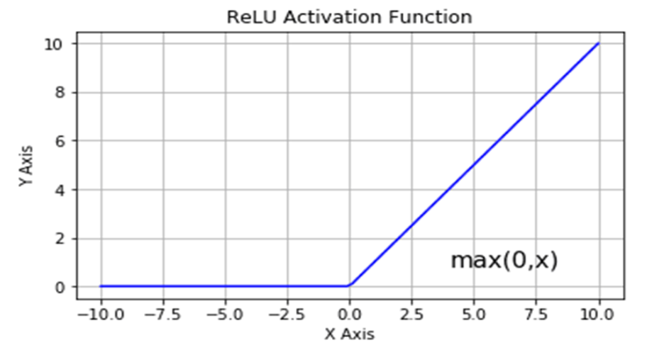
Useful Properties of Common Functions
ReLU (Rectified Linear Unit) function

Slide 28
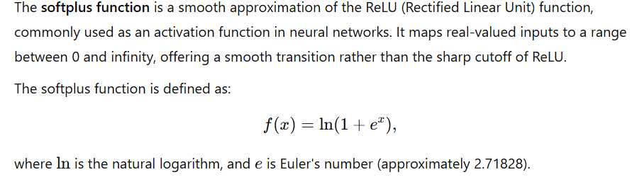
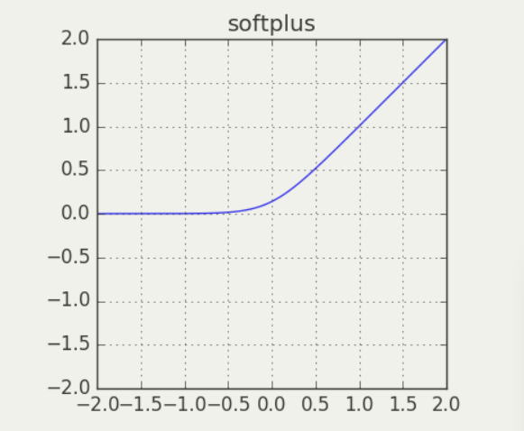
Useful Properties of Common Functions
SoftPlus Function

Slide 29
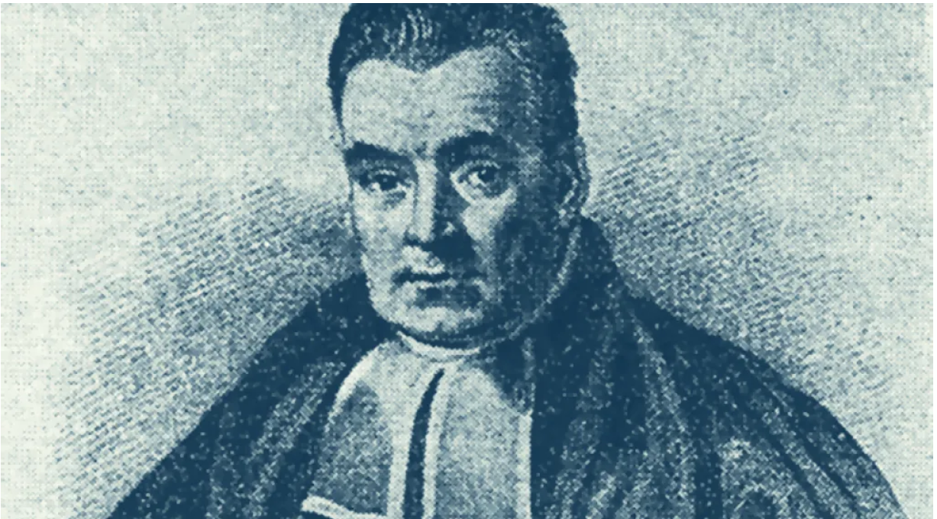
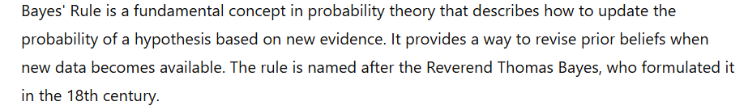
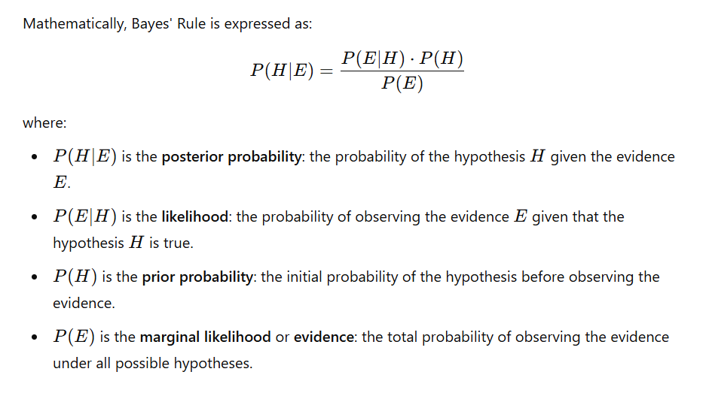
Baye’s rule/Baye’s theorem

Slide 30
Information Theory
Branch of applied mathematics that revolves around quantifying how much information is present in a signal.
It was established by Claude Shannon in his seminal 1948 paper, "A Mathematical Theory of Communication.“
Information theory provides tools to measure information, understand communication systems, and analyze data compression and transmission.
At its core, information theory answers questions like:
How much information is contained in a message?
What is the best way to encode data for transmission or storage?
How can we mitigate the effects of noise during communication?

Slide 31
Basic Intuition of Information Theory
Learning that an unlikely event has occurred is more informative than learning that a likely event has occurred.
The sun rose this morning – Uninformative
There is a solar eclipse this morning – Very Informative

Slide 32
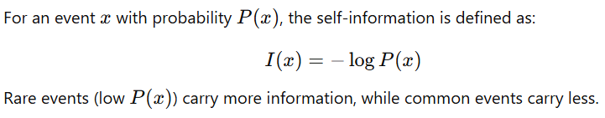
Basic Intuition of Information Theory
We would like to quantify information in a way that formalizes this intuition:
Likely events should have low information content, and in the extreme case, events that are guaranteed to happen should have no information content whatsoever
Less likely events should have higher information content
Independent events should have additive information. For example, finding out that a tossed coin has come up as heads twice should convey twice as much information as finding out that a tossed coin has come up as heads once.

Slide 33
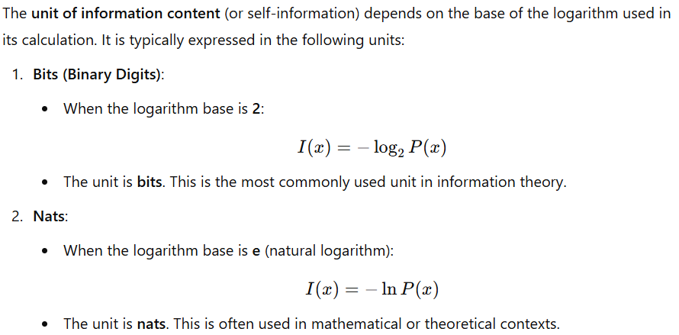
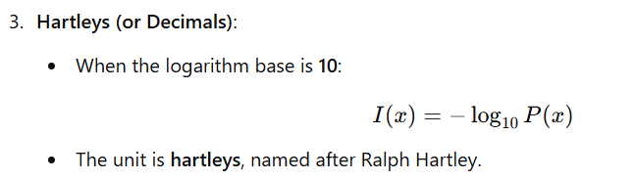
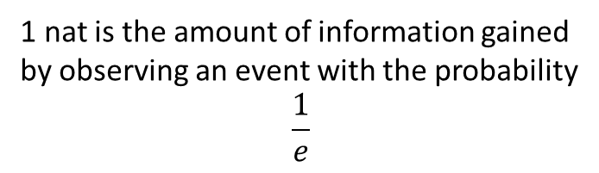
1 nat is the amount of information gained
by observing an event with the probability
$$\frac{1}{e}$$

Slide 34
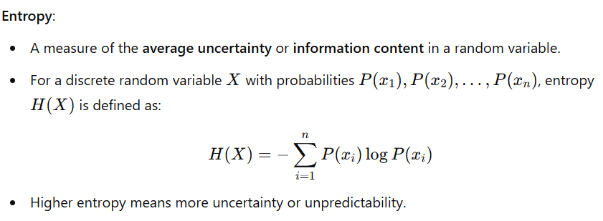
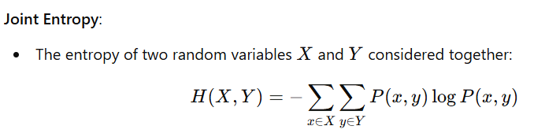
Entropy / Shannon Entropy

Slide 35
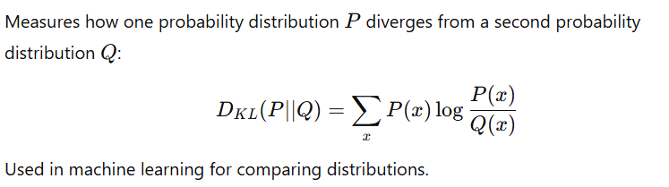
Kullback-Leibler Divergence (KL Divergence)

Slide 36
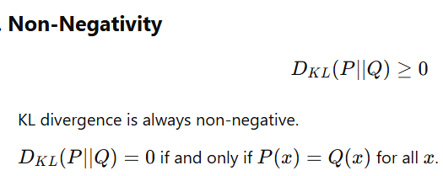
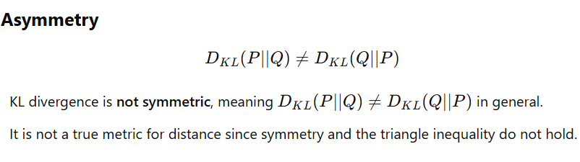
Properties of KL Divergence

Slide 37
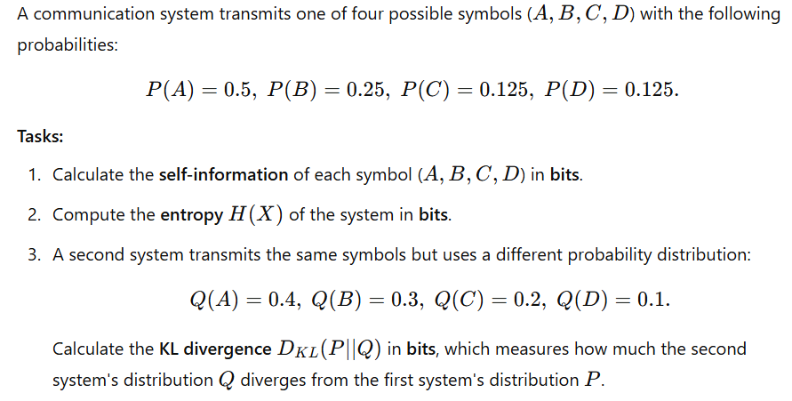

Slide 38
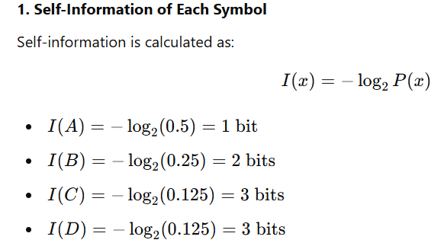
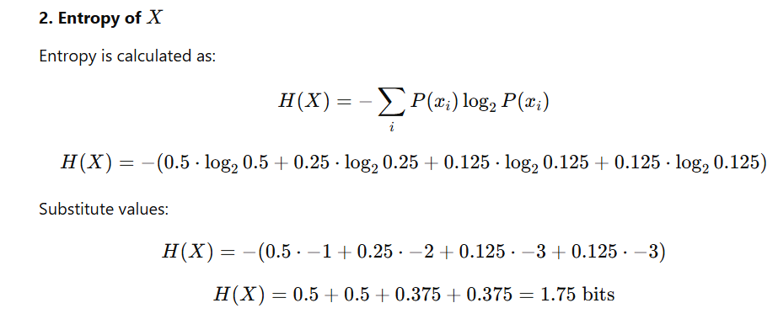

Slide 39
